Slide 1
K-Means Clustering
Who is my neighbor?

Slide 2
K-Means Algorithm
Initialize
Acquire data
Select number of clusters
Create cluster center starting locations
Make initial cluster assignments
Until (time runs out
or assignments stop changing
or means become fixed)
Update cluster center locations
Update cluster assignments

Slide 3
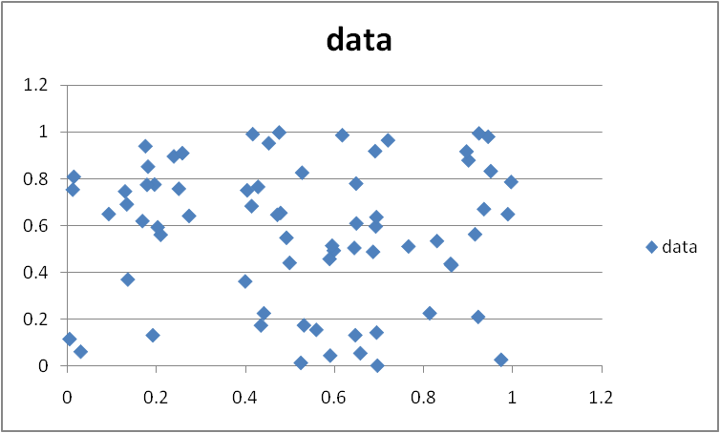
Data

Slide 4
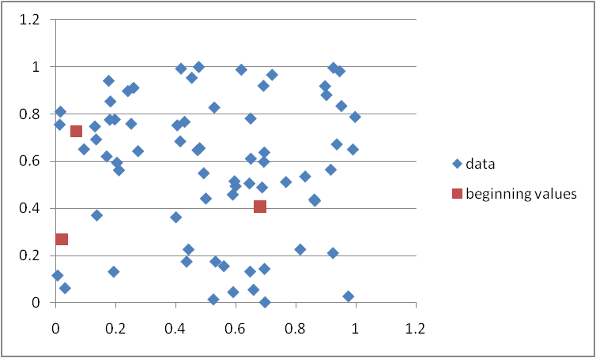
Data with initial cluster centers

Slide 5
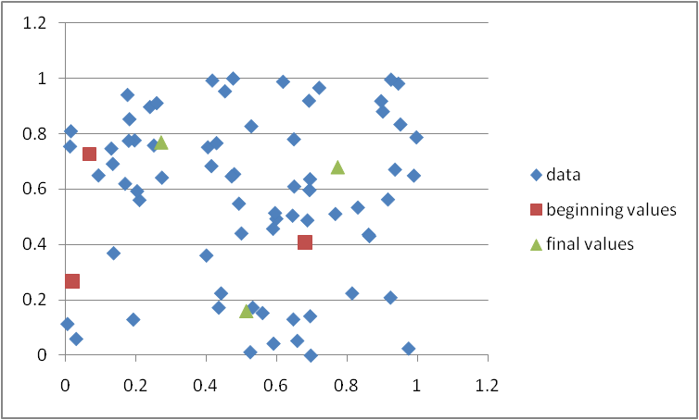
Add the Final Cluster Centers

Slide 6
Relative Merits of k-Means Clustering
Minuses
The number of clusters must be selected first
Oscillations are possible
Plusses
Adaptive
Converges relatively quickly in practice
Simple to implement

Slide 7
Testing Code

